Slide 1
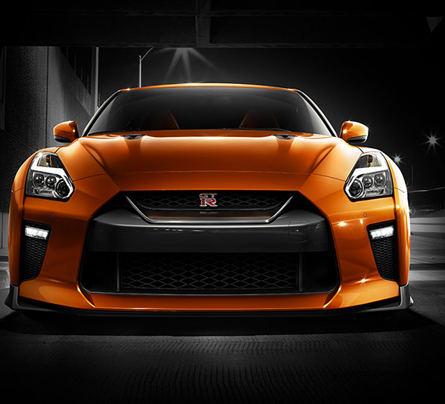
Nissan GTR

Slide 2
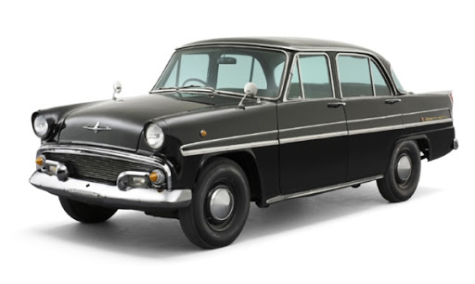
History of Nissan GTR
The legendary Skyline, first introduced in 1957, was originally built by Japan’s Prince Motor Company. Production of the Prince Skyline lasted from 1957 until 1967, when Prince and Nissan merged. With humble origins as a rather modest 4-door luxury car, the Skyline began to evolve into a performance-bred sportscar following the merger. Today the Skyline is most recognized as the influential predecessor to the modern GTR

Slide 3
THE FIRST SKYLINE
The first Prince Skyline was introduced in 1957 and was available in Japan until 1961. The Skyline was available as either a four-door sedan or a five-door station wagon, and it featured a 1.5L GA-30 engine. It wasn’t until 1964 that the first racing GT Skyline was introduced, still under the Prince Motors flag. The introduction of the GT Skyline really marked the Skyline’s shift from sedan to racecar.
THE FIRST-GENERATION NISSAN SKYLINE
In 1966, following the merger of Prince and Nissan, the Skyline finally became a Nissan. It wasn’t until 1969 that the first performance-bred Skyline was unveiled at the Tokyo Motor Show. It was still a sedan, but it now boasted an inline six engine and (impressive for the day) 160 horsepower. The first-generation Nissan Skyline was available from 1969-1972.

Slide 4
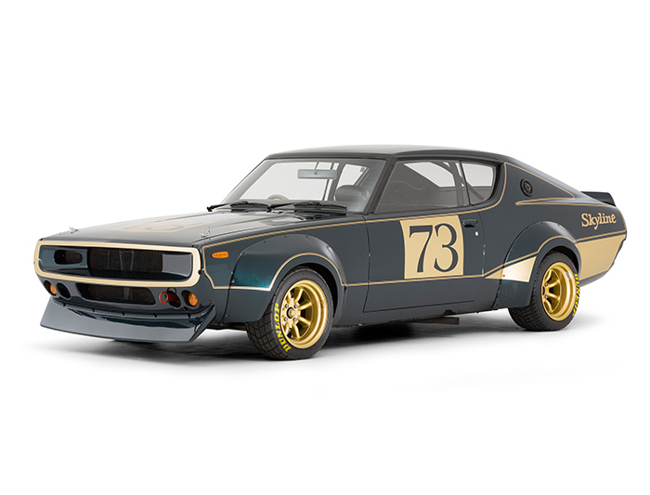
NISSAN SKYLINE TAKES TO THE TRACK
That 1969 version of the Skyline was a touring car like no other. Taking cues from the Nissan Prince R380 racing prototype, it relied on a four-valve Dual Overhead Cam engine for power and four-wheel independent suspension for its remarkable handling. The car obliterated the competition in Japan's domestic touring races, winning 52 races in its first three years of competition.

Slide 5
The first two-door version was introduced in 1970. It was a successful launch and a well-received car, but a global gasoline crisis and a move towards stricter emissions standards put the Skyline on the shelf for a time.
From 1972 to 1977, the C110 generation Skyline was produced, this time though it was known as the Datsun K-Series, and four years later it went through another name change—it was now to be known as the R30. The R30 was a successful and remarkably versatile design, available as a coupe, four-door sedan, five-door hatchback, and a four-door wagon. All told, the R30 was available in 26 variations, none of them really hinting at what the Skyline would one day become.

Slide 6
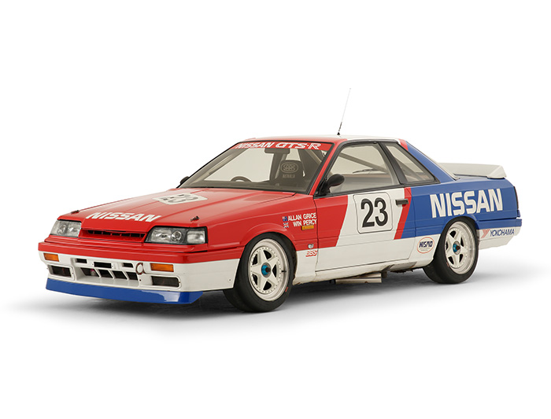
1985 saw the introduction of the R31. It was a little bigger and boxier than previous models, and was the first to get the famous “Red Top" Skyline engine with red cam covers and the Nissan Induction Control System.

Slide 7
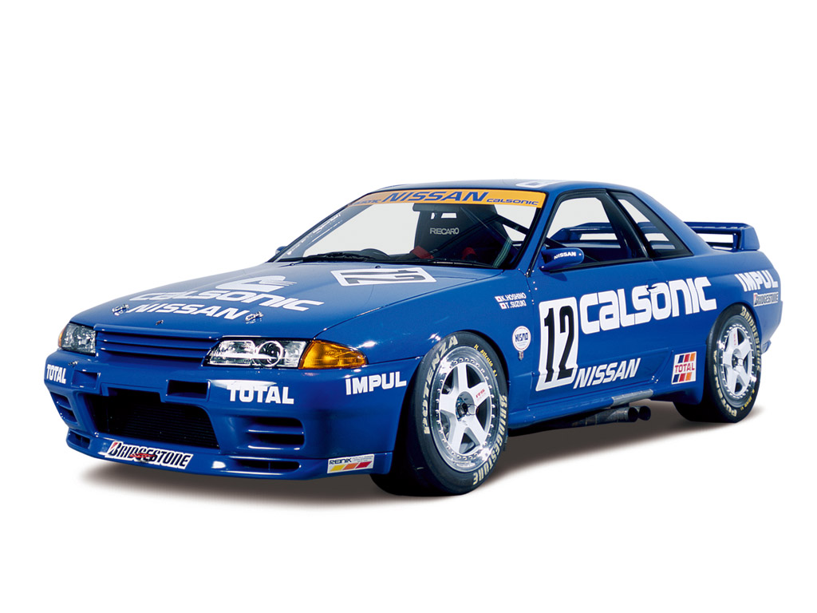
THE R32 SKYLINE GTR
The Skyline has been through many phases, but it was in 1989 that the real precursor to the GT-R of today was introduced. The R32 Skyline had four-wheel drive and the famed Nissan RB26DETT inline six that pumped out 276 horsepower. It still wasn’t sold in America, but the JDM (Japanese Domestic Market) model was and still is a legend in the American tuner community, and a lucky few aficionados were able to legally import them to the States and had them modified to meet US emissions regulations.
A stripped-down version of the R32 entered the Japanese Touring Car Championship in 1989 and won every race it started—29 in a row—over the next four seasons from 1990 through 1993. The legend of the GT-R was truly born on those racetracks.

Slide 8
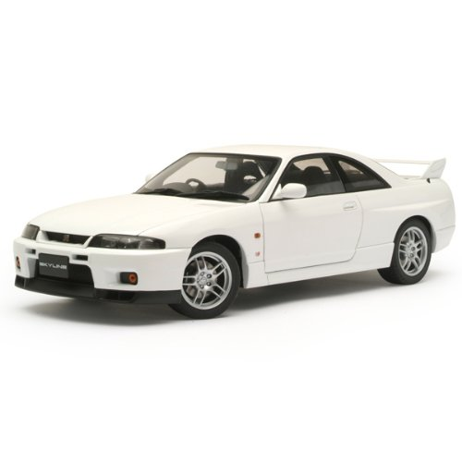
THE R33 SKYLINE GTR
After first appearing to the motoring world as a prototype at the Tokyo Motor Show in 1993, the R33 Skyline GT-R was finally launched to the public in January 1995 with a 6-cylinder inline engine. In its evolution from the R32, the R33 Skyline GT-R became a faster, more stable and fun car, thanks to the highly improved body stiffness, better weight distribution and optimized traction control provided by the new 4WD system “ATTESA E-TS PRO”.

Slide 9
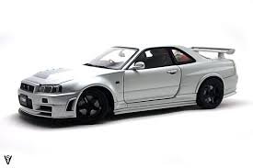
THE R34 SKYLINE GTR​
The R34 Skyline GT-R, introduced in 1999 and available until 2002, featured a technologically advanced display unit which set the model apart. While it retained the RB26DETT engine of the R32 and R33, producing an impressive 276 horsepower, the shorter wheelbase and more streamlined body of the R34 helped it to achieve even higher performance than its predecessors.

Slide 10
THE FIRST NISSAN GTR R35
In 2008, the GT-R finally, officially, landed on American roads. Nissan dropped the Skyline name and added a twin-turbo V6 that put out 473 horsepower, propelling the GT-R to performance levels that could not only compete with but outclass legendary American muscle cars and German and Italian supercars. Overnight, the GT-R became a legend. Its technologically advanced road-grabbing all-wheel drive provided exhilarating handling, and it was all wrapped up in a sleek, yet muscular, modern exterior design.
The first Skyline engine, introduced by the Prince Motor Company in 1957, was a 1.5-liter 4-cylinder power plant that produced 60 horsepower. Yes, 60 horsepower.
Fast-forward to 1989, when Nissan introduced a new RB26DETT engine with the R32 Skyline GT-R. This powerful (at the time) 2.6-L twin-turbo was capable of producing 280 PS (162 kW; 276 hp) and had 260 lb-ft of torque.

Slide 11
SPECIFICATIONS
2020 Nissan GT-R NISMO
VEHICLE TYPE front-engine, all-wheel-drive, 4-passenger, 2-door coupe
BASE PRICE $212,435
ENGINE TYPE twin-turbocharged and intercooled DOHC 24-valve V-6, aluminum block and heads, port fuel injection
Displacement 232 cu in, 3799 cc Power 600 hp @ 6800 rpm Torque 481 lb-ft @ 3600 rpm
TRANSMISSION 6-speed dual-clutch automatic with manual shifting mode
DIMENSIONS Wheelbase: 109.4 in Length: 184.6 in Width: 74.6 in Height: 53.9 in Passenger volume: 79 cu ft Trunk volume: 9 cu ft Curb weight: 3850 lb
PERFORMANCE (C/D EST) Zero to 60 mph: 3.0 sec Zero to 100 mph: 6.9 sec Standing ¼-mile: 11.2 sec
EPA FUEL ECONOMY (C/D EST) Combined/city/highway: 18/16/22 mpg

Slide 12
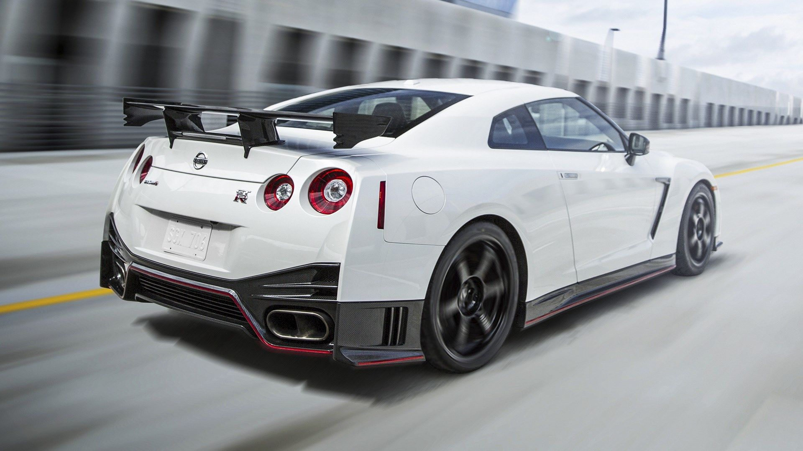
THANK YOU

